Slide 1

GPU-VPM
A GPU-based aerodynamics solver
Nadine Adnane | Dominik Kau | Shreyas Singh

Slide 2
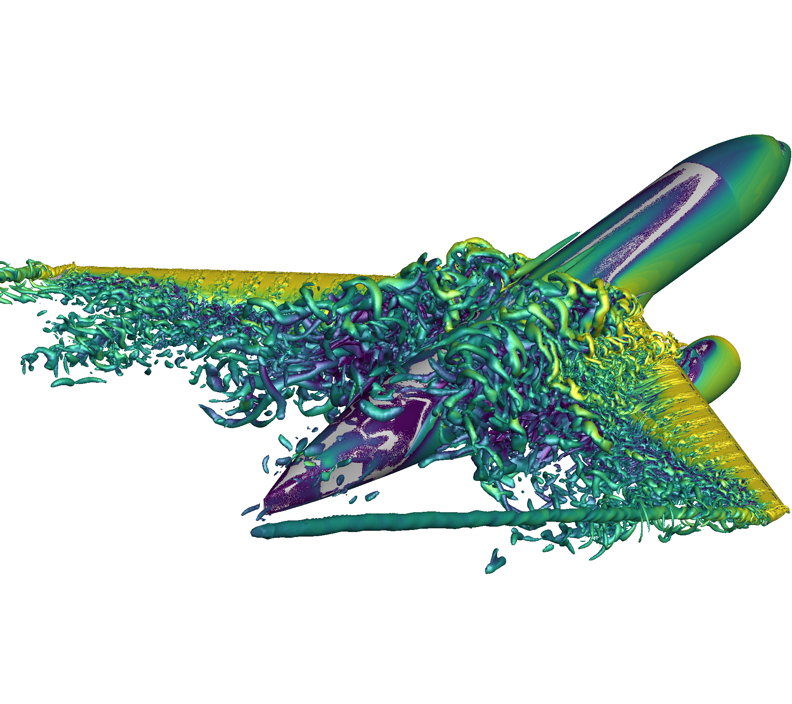
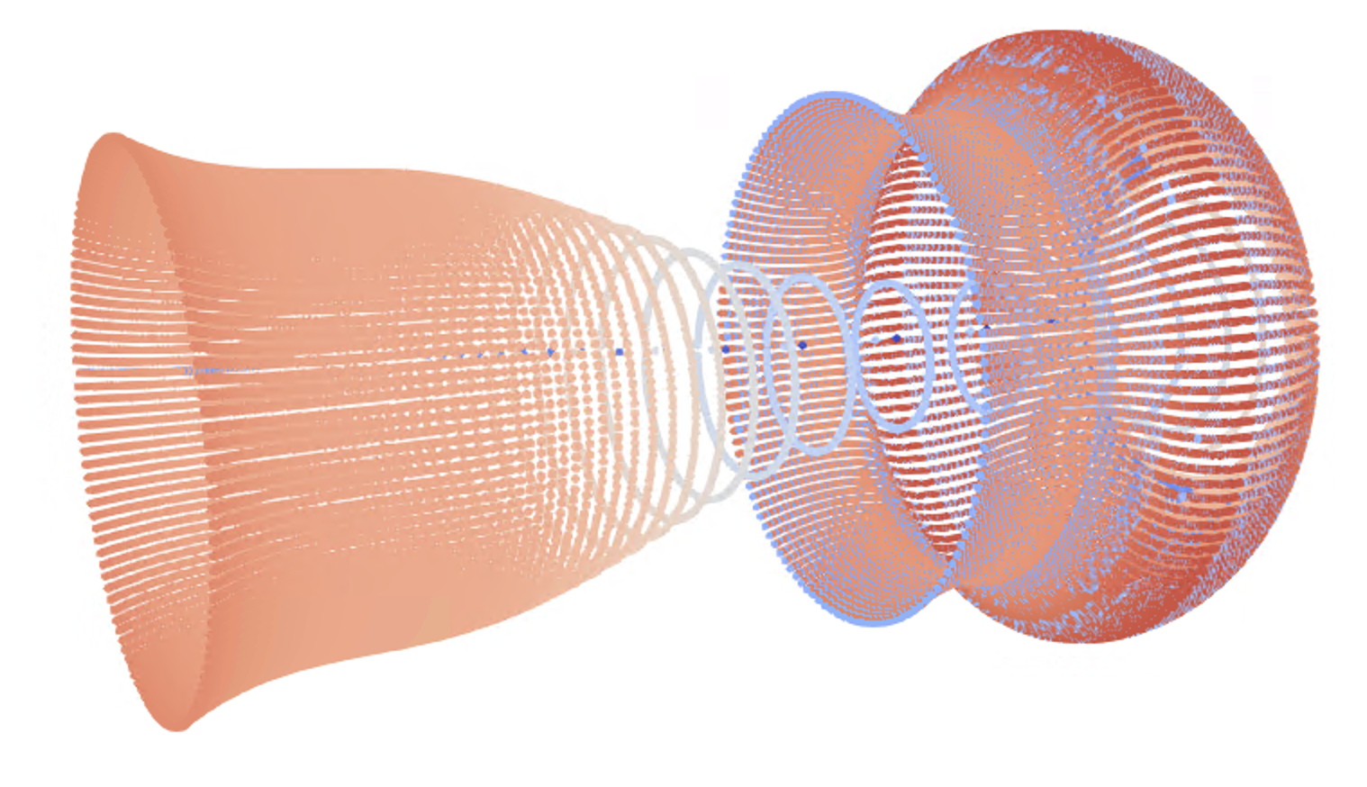
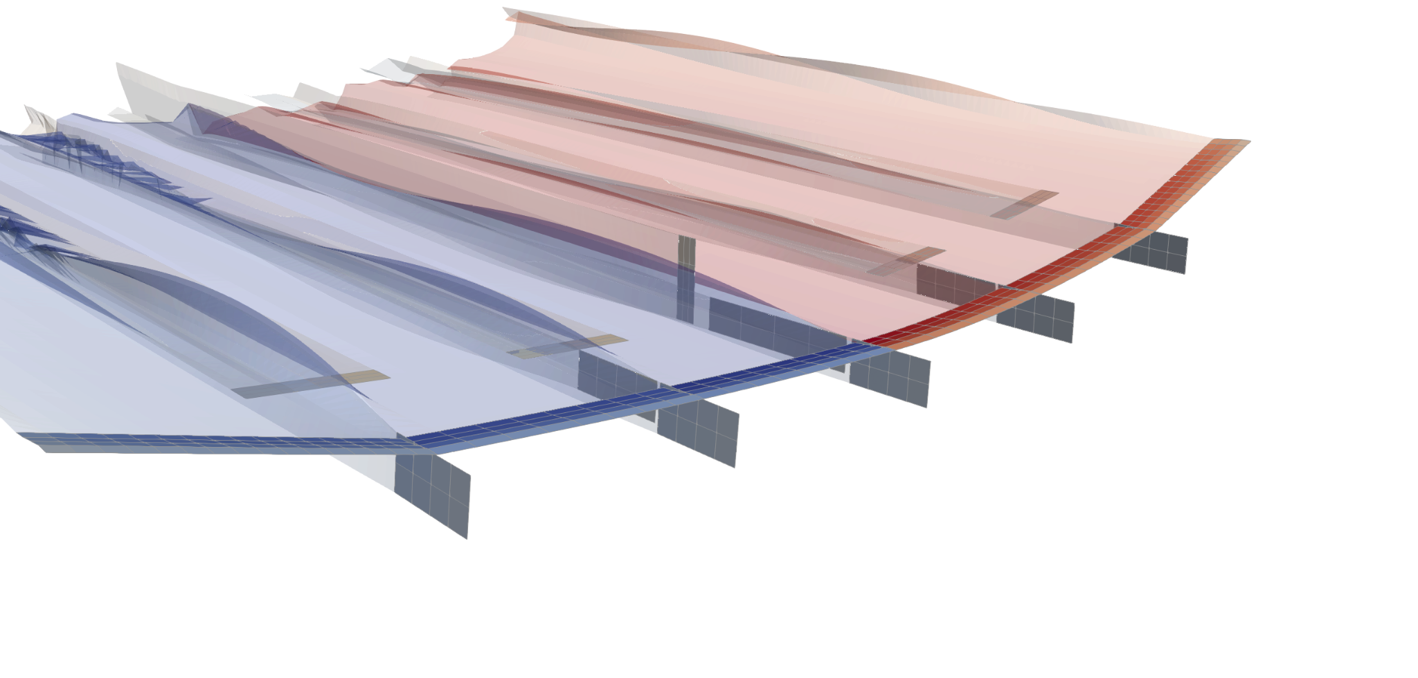
VORTEX PARTICLE METHOD
Vortex Particle Method
Mesh-Based CFD
Panel methods
Low Fidelity
High Computation Cost
Free-wake Methods
Left: https://ic-sharpy.readthedocs.io/en/main/_images/xhale.png
Middle: ours!
Right: https://www.flexcompute.com/blog/2022/12/02/cfd-simulation-methods-for-high-lift-aircraft-configurations-part-1-of-3/
Notes:
Located between low fidelity methods for conceptual design (seconds - hours, depending on accuracy)
And high fidelity CFD (cluster, up to weeks of computation)
Our project: single GPU, computation time up to hours for highest fidelity
Reformulated VPM developed in PhD thesis by Alvarez (contacted on LinkedIn, excited for our implementation)
Reformulated: fixes stability problems of old implementations
N-body problem → particle based computation, every particle exerts a force on each other particle

Slide 3


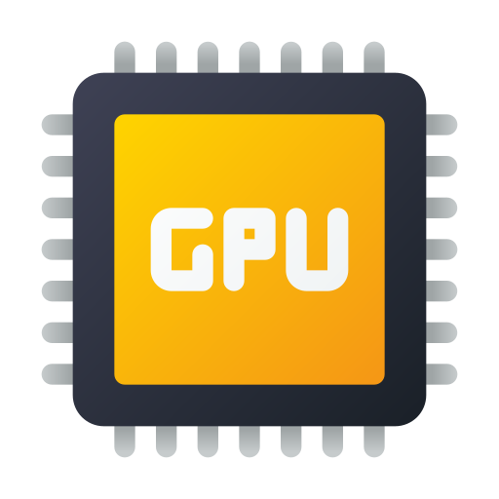

Why does this matter?
Balances speed and accuracy
Enable faster design process in aeronautics industry
Open source GPU implementation = More accessible AND efficient!
VPM has only been implemented on CPU so far
Notes:
Completed VLM implementation on CPU
Concluded basic implementation of VPM
CUDA implementation
Challenges: simulation options in form of functions (e.g. Kernel, turbulence model)
Easy to do in Julia
Solved with lots of templates
Not all option of original version implemented -> in most cases the most accurate version according to thesis implemented
Challenges were simulation options in form of functions

Slide 4
OVERVIEW
VPM SOLVER (Reformulated & Classical Formulation)
Time Integration
Cases
Turbulence Model
No Model
Dynamic Model
Kernel
Singular
Gaussian
Gaussian Erf
Winckelmans
Vortex Rings
Turbulent Jet
Relaxation Model
No Relaxation
Pedrizzetti Relaxation
Corrected Pedrizzetti Relaxation
Induced Velocity
Naive evaluation
Fast Multipole Method
Output
Point Cloud Export
Viscosity Model
Vortex Ring Metrics

Slide 5
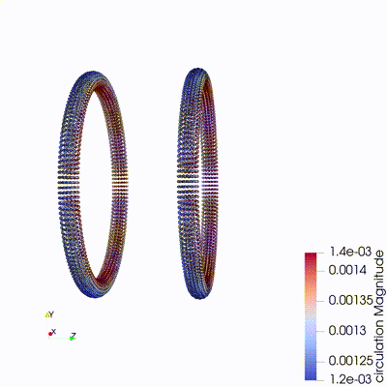
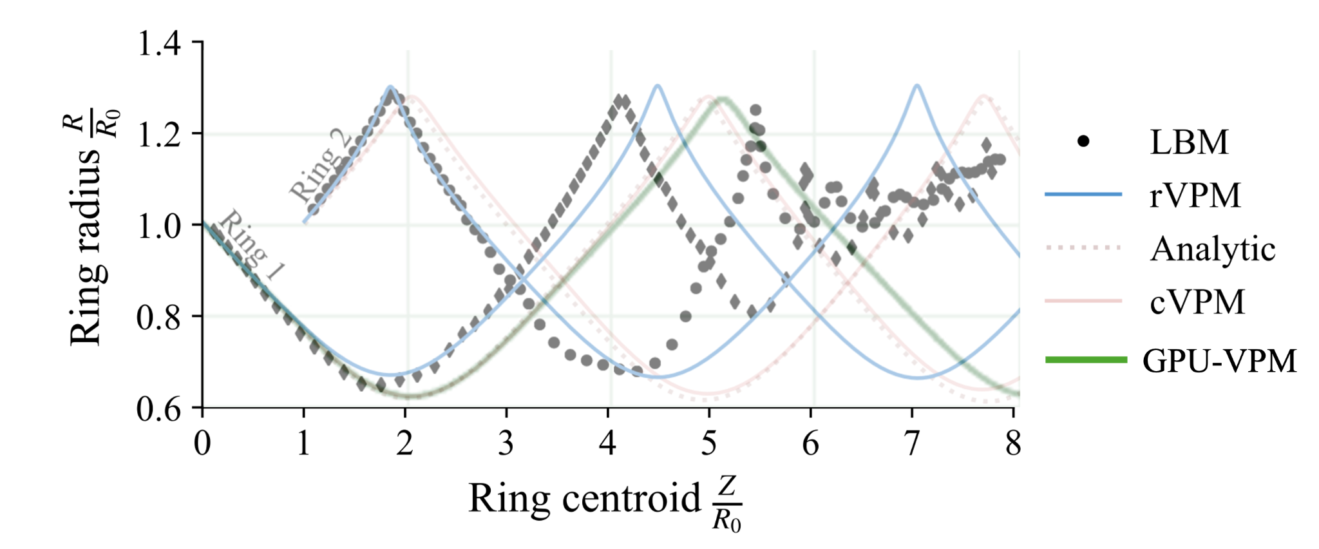
Vortex Ring Simulation
Verification with results from Ed Alvarez Thesis

Slide 6
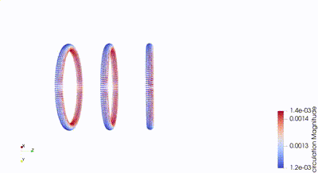

Slide 7
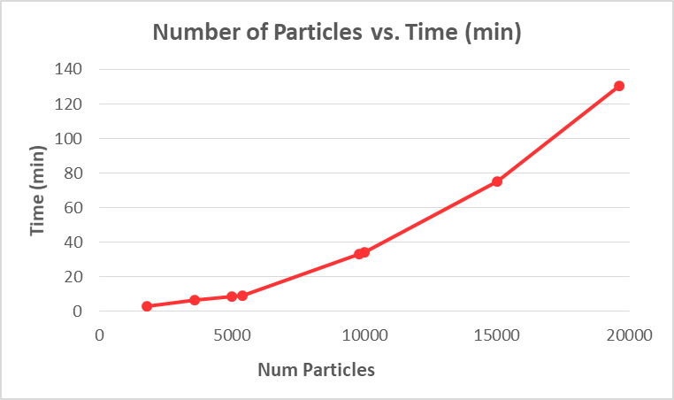
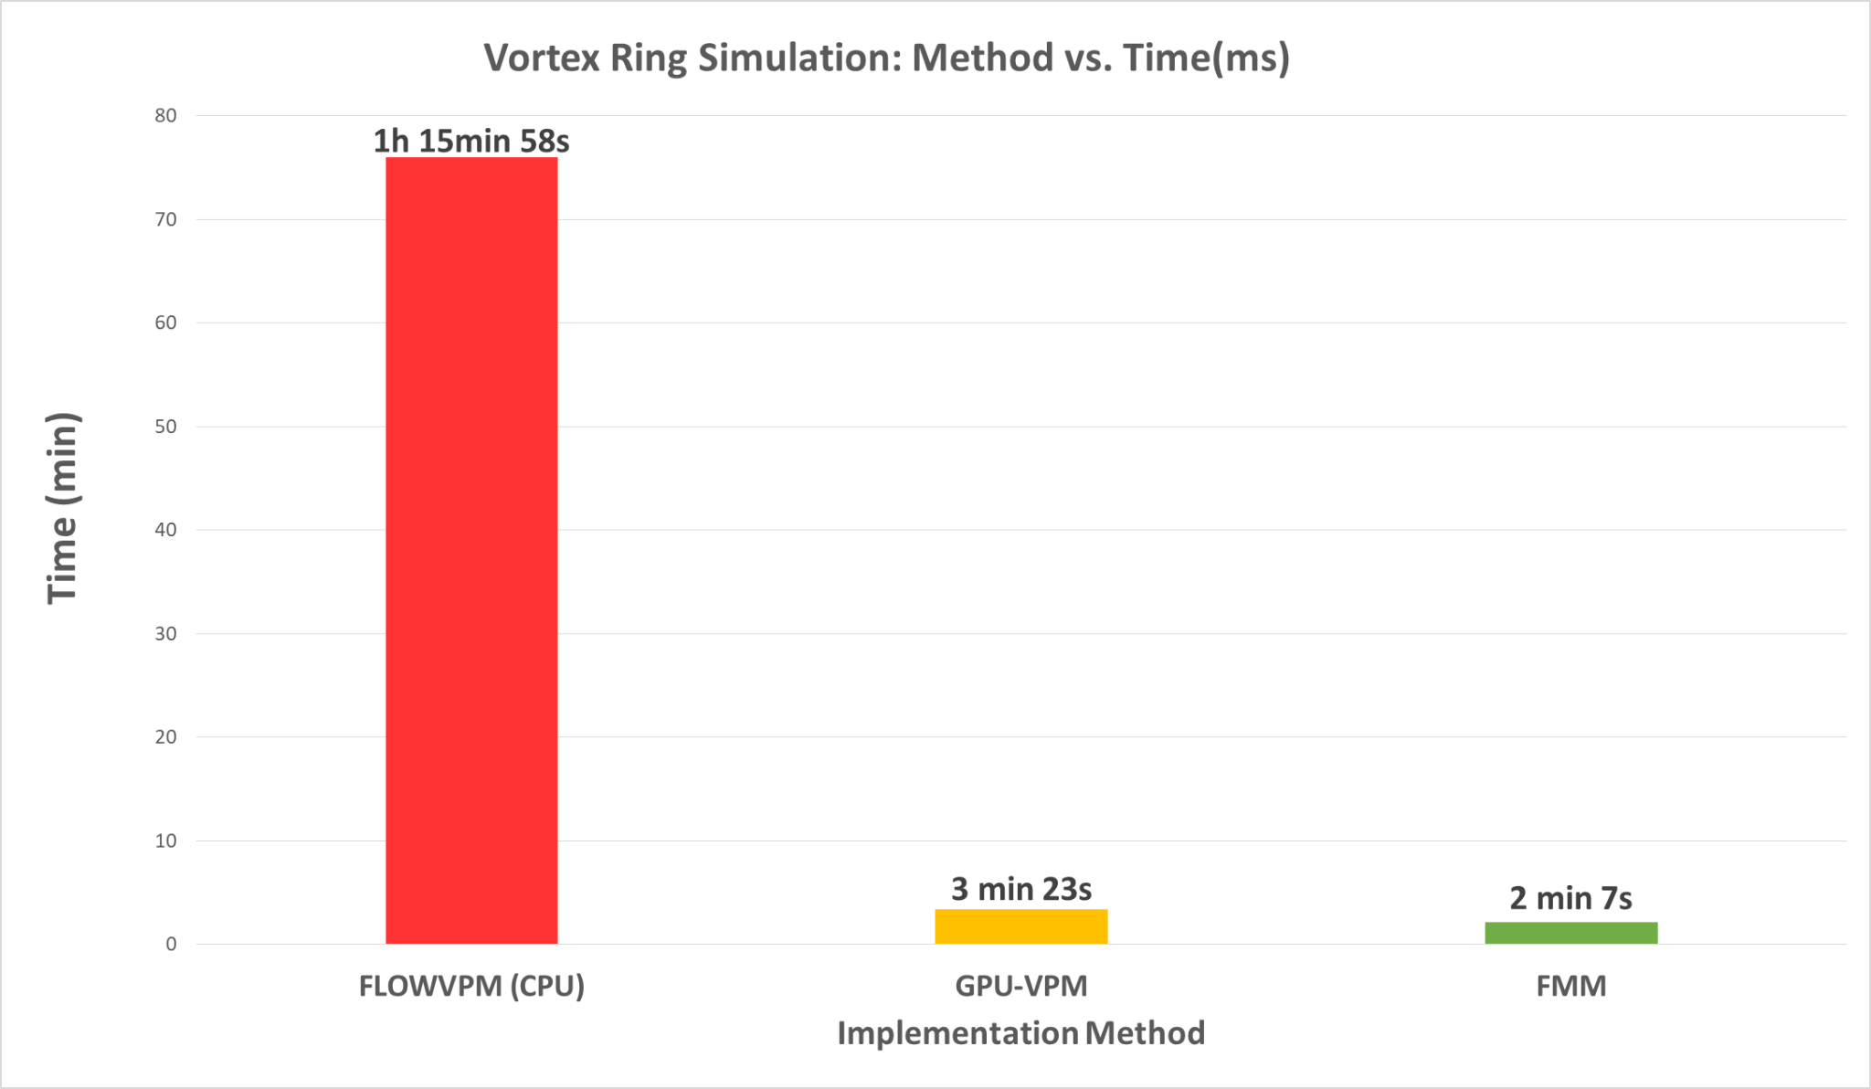
Vortex Ring Simulation
GPU-VPM is 23x faster
than the original CPU implementation!
Notes:
ParaView is the world’s leading open source post-processing visualization engine.
Lightweight library in C++ for easy export
Export unstructured grids= point cloud
Export at every nth step -> easy animation
Show pictures of random initialization

Slide 8
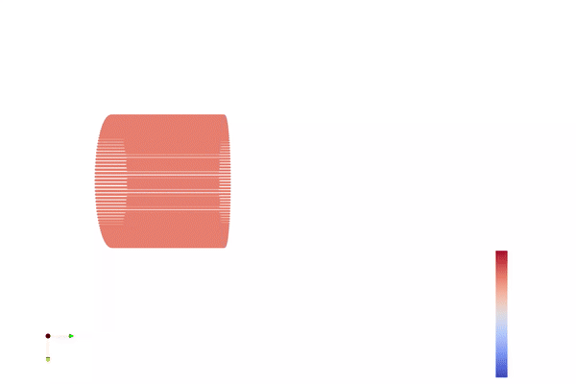
Turbulent Round Jet Simulation
A turbulent round jet discharging into a quiescent environment.

Slide 9
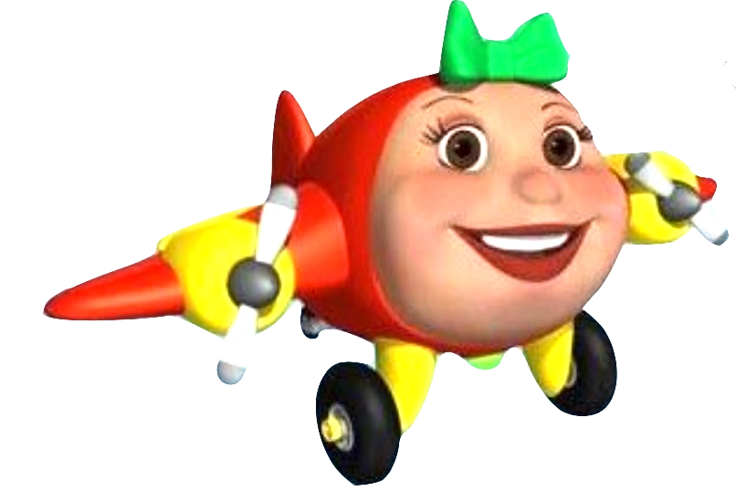

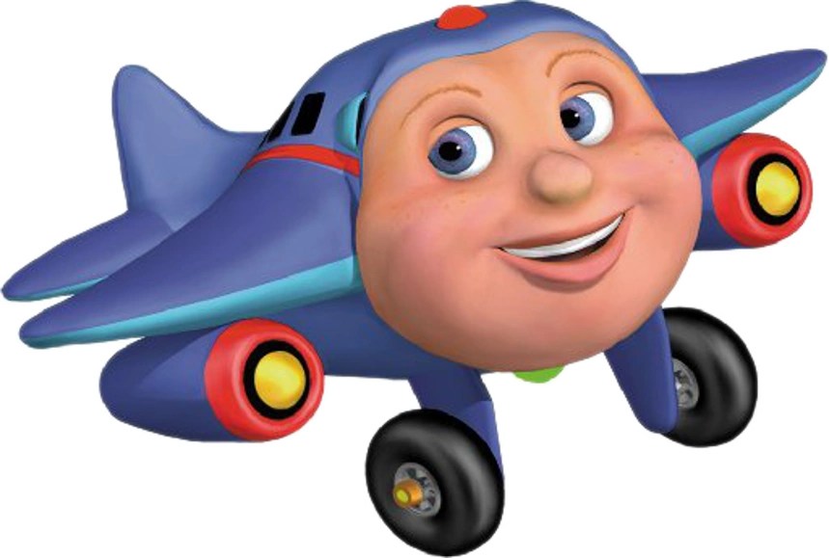

Thank you! :)

Slide 10
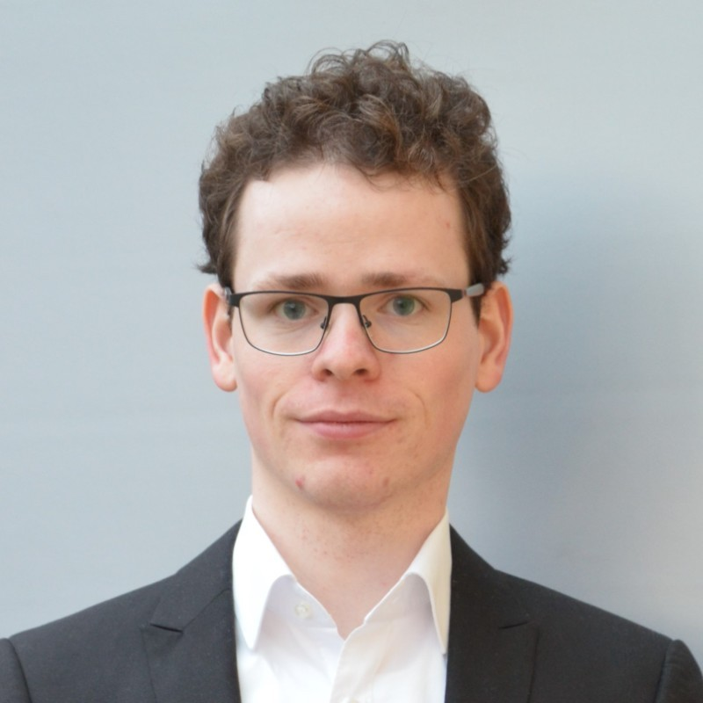


CONTACT US
Dominik Kau
Nadine Adnane
Shreyas Singh
dominikk@seas.upenn.edu
/in/dominikkau
nadnane@seas.upenn.edu
/in/nadnane
shreyas4@seas.upenn.edu
/in/shreyassinghiitr

Slide 11
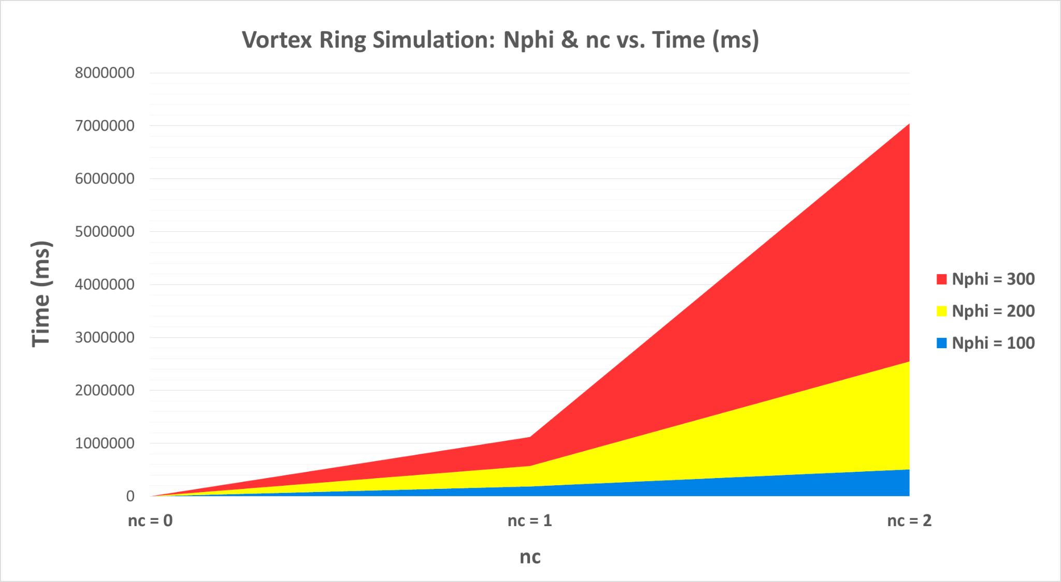
Vortex Ring Simulation
Notes:
ParaView is the world’s leading open source post-processing visualization engine.
Lightweight library in C++ for easy export
Export unstructured grids= point cloud
Export at every nth step -> easy animation
Show pictures of random initialization

Slide 12
GPU-VPM is 23x faster
than the original CPU implementation!
Notes:
ParaView is the world’s leading open source post-processing visualization engine.
Lightweight library in C++ for easy export
Export unstructured grids= point cloud
Export at every nth step -> easy animation
Show pictures of random initialization

